Slide 1
DATA 824 Final Project
CFB Gambling Data Analysis
Alex Rottinghaus

Slide 2
Background
I love sports betting, it’s one of my many passions. I also love data science, so I’ve decided to combine those two passions for this project. Obviously, the world of sports gambling is much too large to put into one data project. So for this project, I decided to build a dashboard to that will allow you to see a few different metrics and charts for how each Big 12 football team fared against the spread (as provided by the sportsbook Bovada).

Slide 3
Background (cont.)
As I stated in the previous slide, this project consisted of me essentially building an interactive dashboard with college football gambling data. The data I obtained was from the R API wrapper called “cfbfastR”. This API allows the user to pull all sorts of data from both collegefootballdata.com and espn.com. There is so much data (literally millions of rows) that the wrapper has access to, but as I said, I’m going to focus on Big 12 football gambling data, as to not overwhelm you with too much information.

Slide 4
Dataset
Columns:
Game_id - unique identifier for the game
Season - year, all records in this dataset will be 2022
Week - Week of the regular season in which the game was played
Home_team - The home team for the game record
Away_team - The away team for the game record
Home_score - Final score for the home team
Away_score - Final score for the away team
Spread - Point spread provided by Bovada at the time of kickoff (i.e. how much was the home_team favored by)
Formatted_spread - Character string containing the team that is favored concatenated with the spread
Over_under - The total O/U provided by Bovada at the time of kickoff. To bet this, you’re bettin if you think the total point will be higher or lower than the O/U number provided
Home_moneyline - American payout odds if the home_team wins (must bet the home team to win the game, not just cover the spread)
Away_moneyline - American payout odds if the away_team wins (must bet the away team to win the game, not just cover the spread)
Rows:
45 Big 12 games were played this regular season between two Big 12 teams
They play a round-robin schedule with 10 teams, so the total games (minus the championship) is 10 choose 2 = 45 games

Slide 5
Gambling Definitions
Spread - the number of points the favorite is expected to win by according to the sportsbook
Betting the dogs - Betting the underdog will win or lose by less than the spread
Betting the favorite - Betting the favorite will win by at least the spread
Push occurs when the spread is equal to the difference of the underdog score and the favorite score
Over/Under - the total number of points the sportsbook believes will be scored in the game
Taking the Under - Betting that less points will be scored than the over/under
Taking the Over - Betting that more points will be scored than the over/under
Push for the over/under means the actual points scored in the game equals the over/under, nobody wins, money is refunded
Moneyline - American odds payout for picking the winner of the game, regardless of the spread.
If betting the favorite, this will pay out worse for larger spreads.
If betting the underdog, this will pay out better for larger spreads

Slide 6
The Application
My application is a shiny dashboard that provides breakdowns of how a selected team has performed in the betting market during the 2022 Big 12 season. There are a few different sections to the dashboard.
Side Panel - General Team Information
Main Panel
Game Log for Selected Team
Interactive scatterplot displaying team performance against the spread and the moneyline for each game

Slide 7
The Side Bar
The side bar in the app has a drop down that allows you to select which team you would like to analyze. Once that is selected a few different things will happen. The tabset panel with three different tabs will update in the side panel. Those first tab will show overview information, such as record, record against the spread, and over/under record in the format of (Over-Under-Push). The second tab will show payout information. The payout values are how much profit you would have made for the conference season betting $100 of each bet type every single game on the selected team. The final tab displays point differential information, such as predicted season point differential, actual season point differential, and the performance value, which is just the magnitude by which a team outplayed or underplayed their expectations. An example of each tab is on the next screen with Kansas State as the selected team.

Slide 8
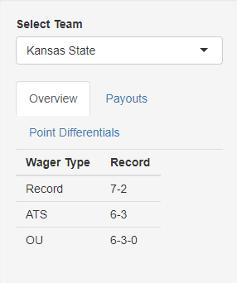
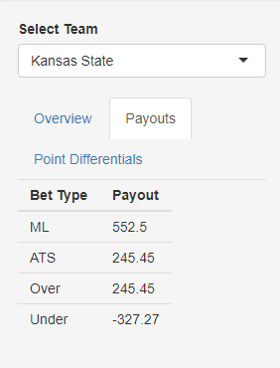
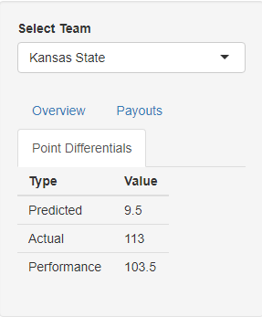

Slide 9
Main Panel - Game Log
The game log shows a game by game record of both betting information and actual game results. I could go through each variable, but that would take a lot of time and my explanations from earlier slides should make it easy enough to follow.

Slide 10
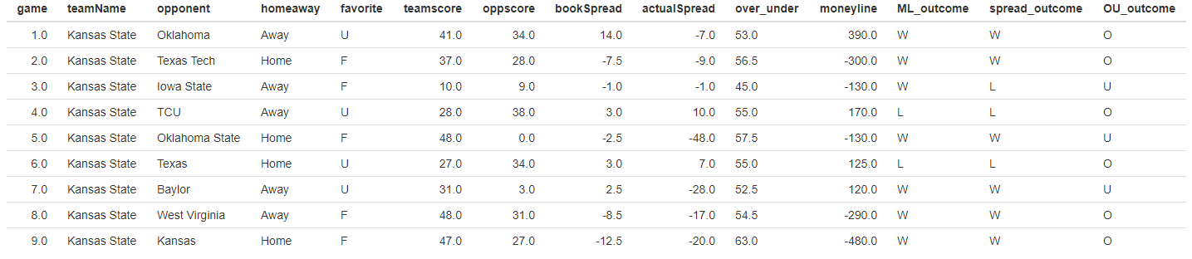

Slide 11
Main Panel - Interactive Scatterplot
The second part of the main panel holds an interactive scatterplot that allows the user to hover over the points and it will show the score of the game, as well as whether or not the spread was covered, and the moneyline was won. The shapes are the differentiator for covering the spread, the colors are the differentiator for moneyline wins. The line going through the origin can also be used to observe whether or not the moneyline had been won, as a point above the line would indicate a win.

Slide 12
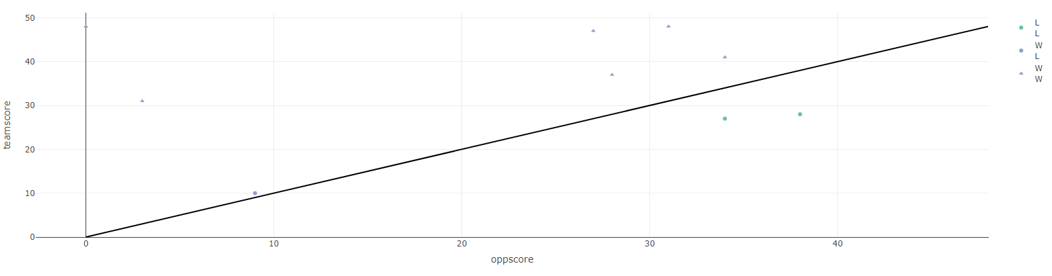

Slide 13
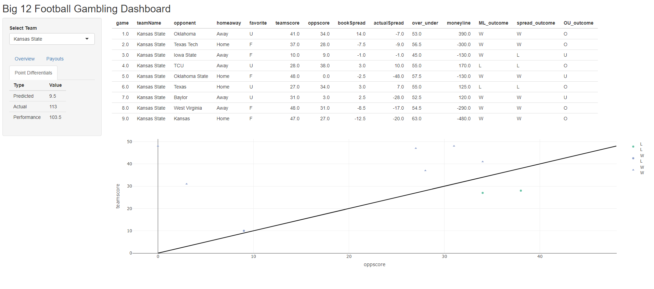
Wholistic Application View

Slide 14
Application Insight
In its current form, my application can already help the inexperienced gambler analyze how well a team has performed historically. However, in the future, I’d like the develop this dashboard even further to encompass more historical data to allow me to do more data slicing to see how they performed on the road or at home, as underdogs v. favorites, and things of that nature. However, this particular dashboard is already beneficial for the novice sports gambler.

Slide 15
Github Repository
https://github.com/14rottinghausaj/DATA-824-Project

